Slide 1

Task 1: Customer review insights
By Viraj Panchal
03-Jan-2024

Slide 2
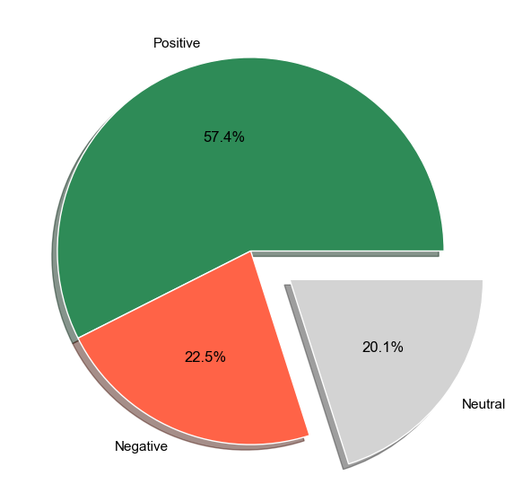
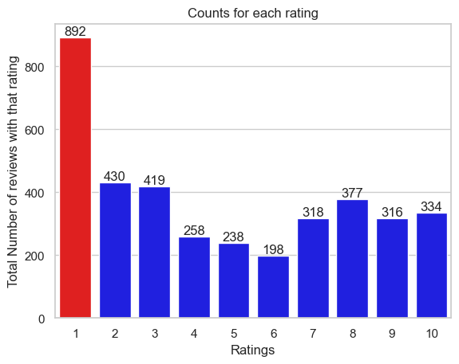
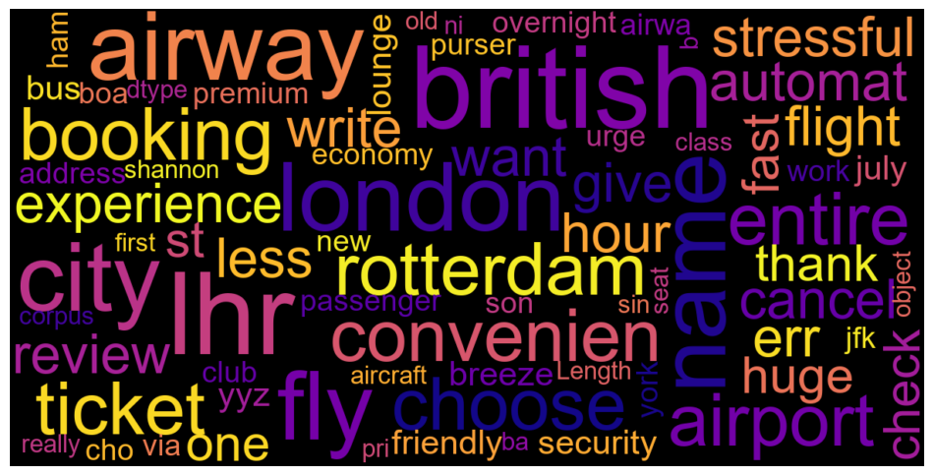
Insights
Customer Review Insights
Average Overall Rating
4.72/10
3780 Total reviews
collected
Customer Reviews
Positive Reviews - 2171
Negative Reviews - 850
Neutral Reviews – 759

